Slide 1
Developer Workshop
Nic Raboy - @nraboy
Senior Developer Advocate at Couchbase

Slide 2
AGENDA
Installing and Configuring Couchbase
Introduction to Data Modeling
Configuring and Using RBAC
CRUD Operations in Couchbase
Querying for Documents with N1QL
Working with Parts of a Document
Full Text Search

Slide 3
Installing and Configuring Couchbase

Slide 4
The Plan – Installing and Configuring Couchbase
Install Couchbase Locally
Create a new Couchbase Bucket
Create Data via the Document Explorer

Slide 5
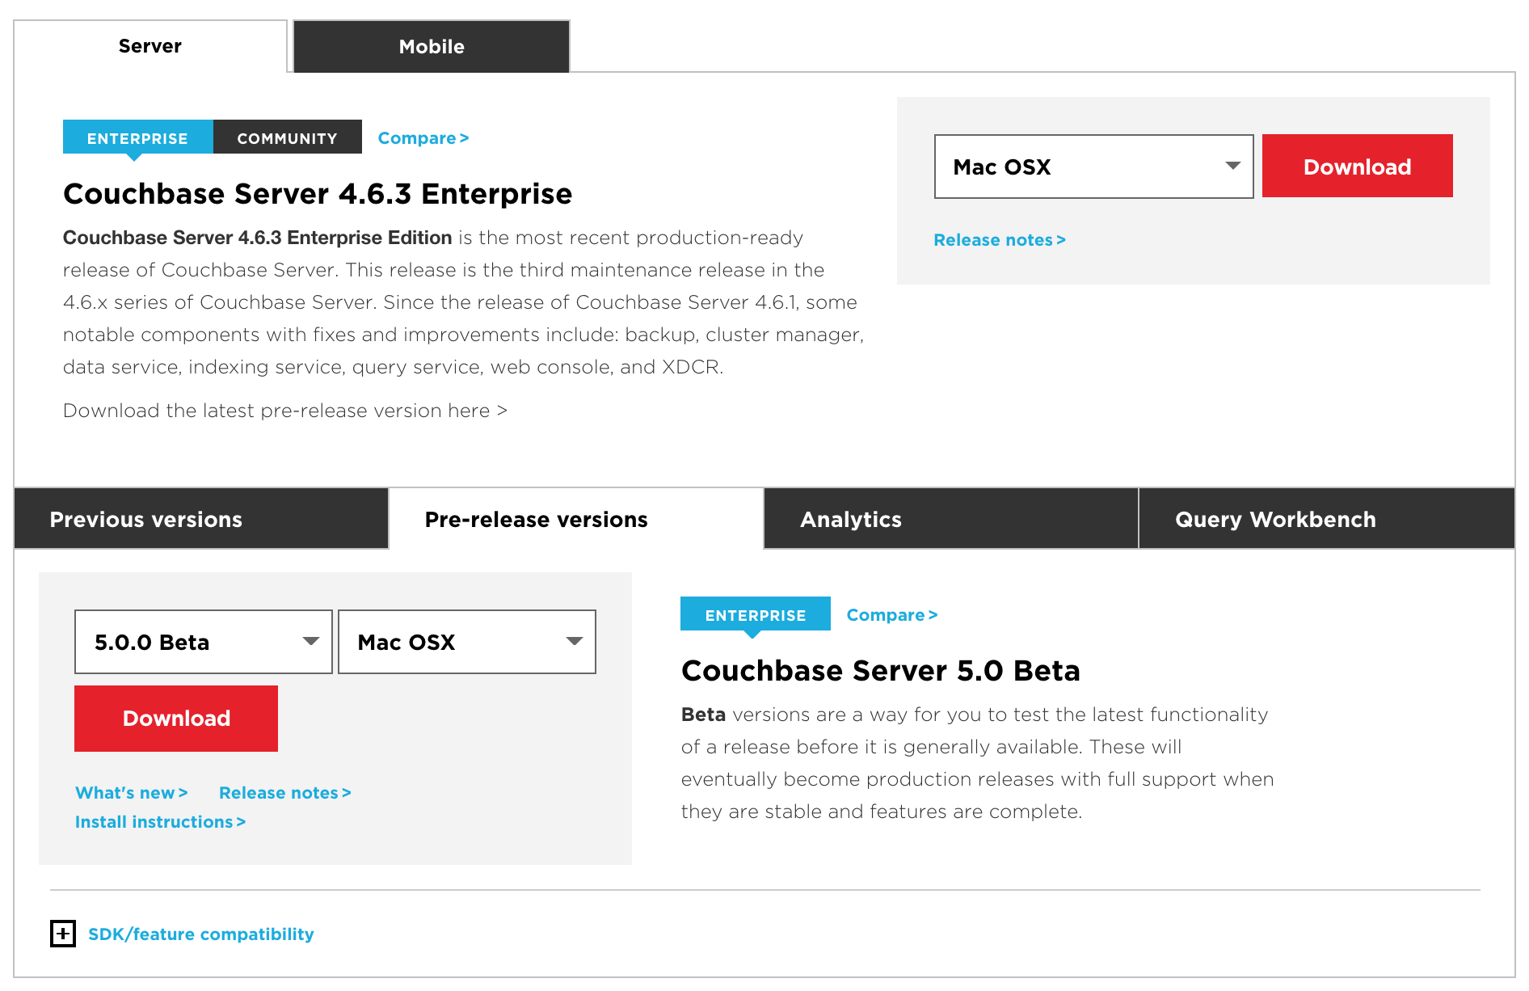
Download Couchbase Server 5.0
Download Couchbase Server 5.0
https://www.couchbase.com/downloads
USB Drives Available

Slide 6
Alternative Download Options
Docker
Amazon Web Services
Microsoft Azure

Slide 7
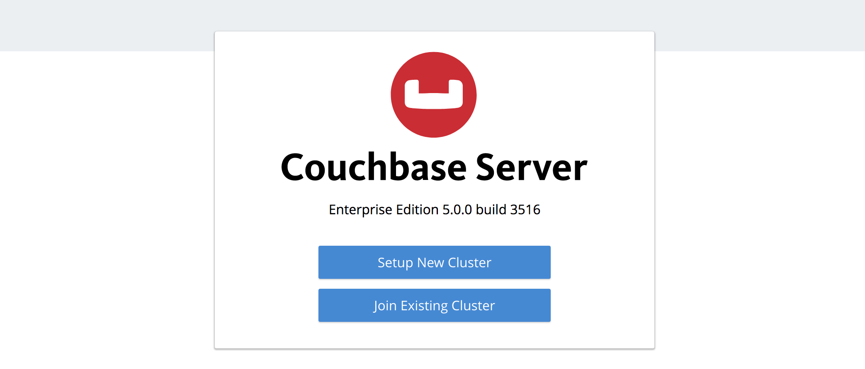
Installing Couchbase

Slide 8
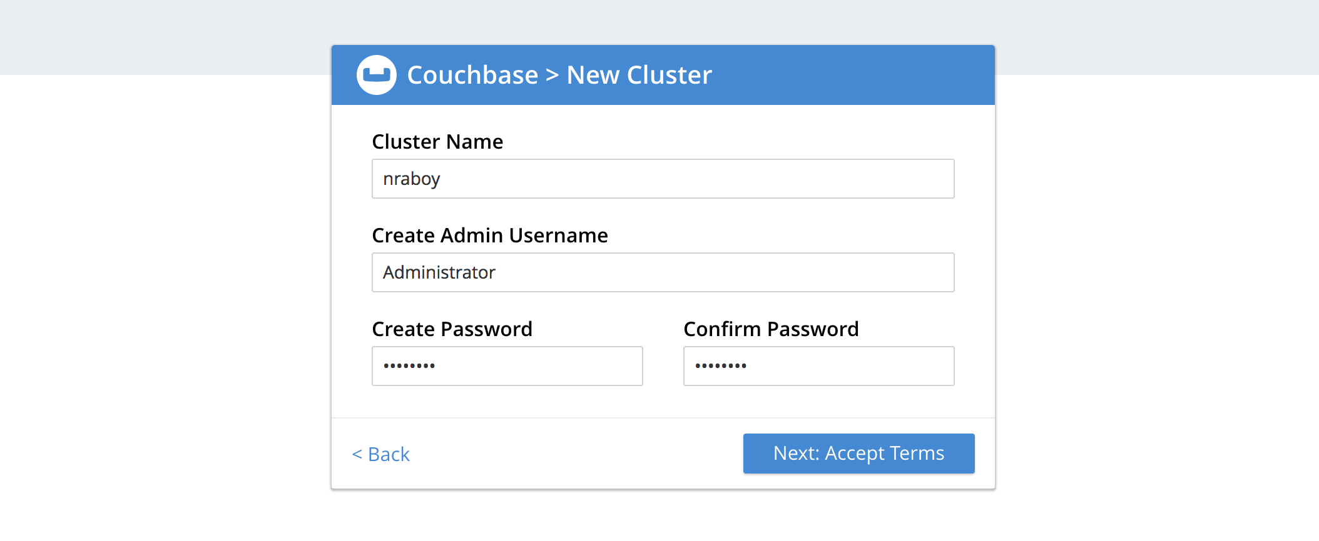
Installing Couchbase

Slide 9
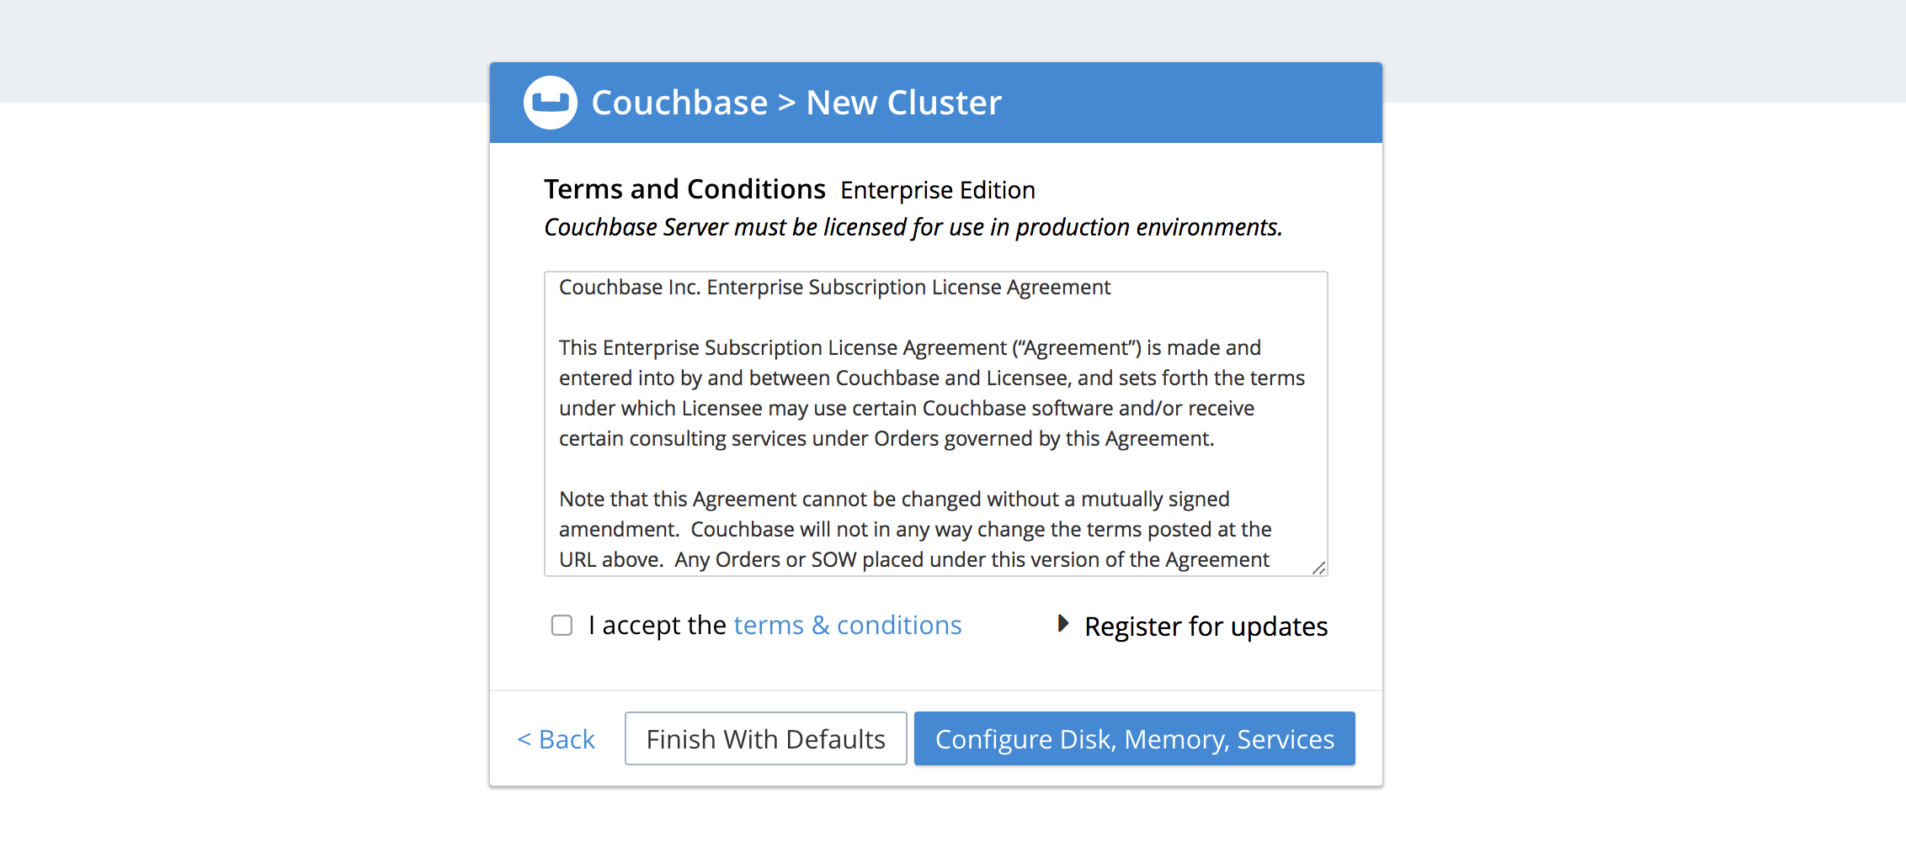
Installing Couchbase

Slide 10
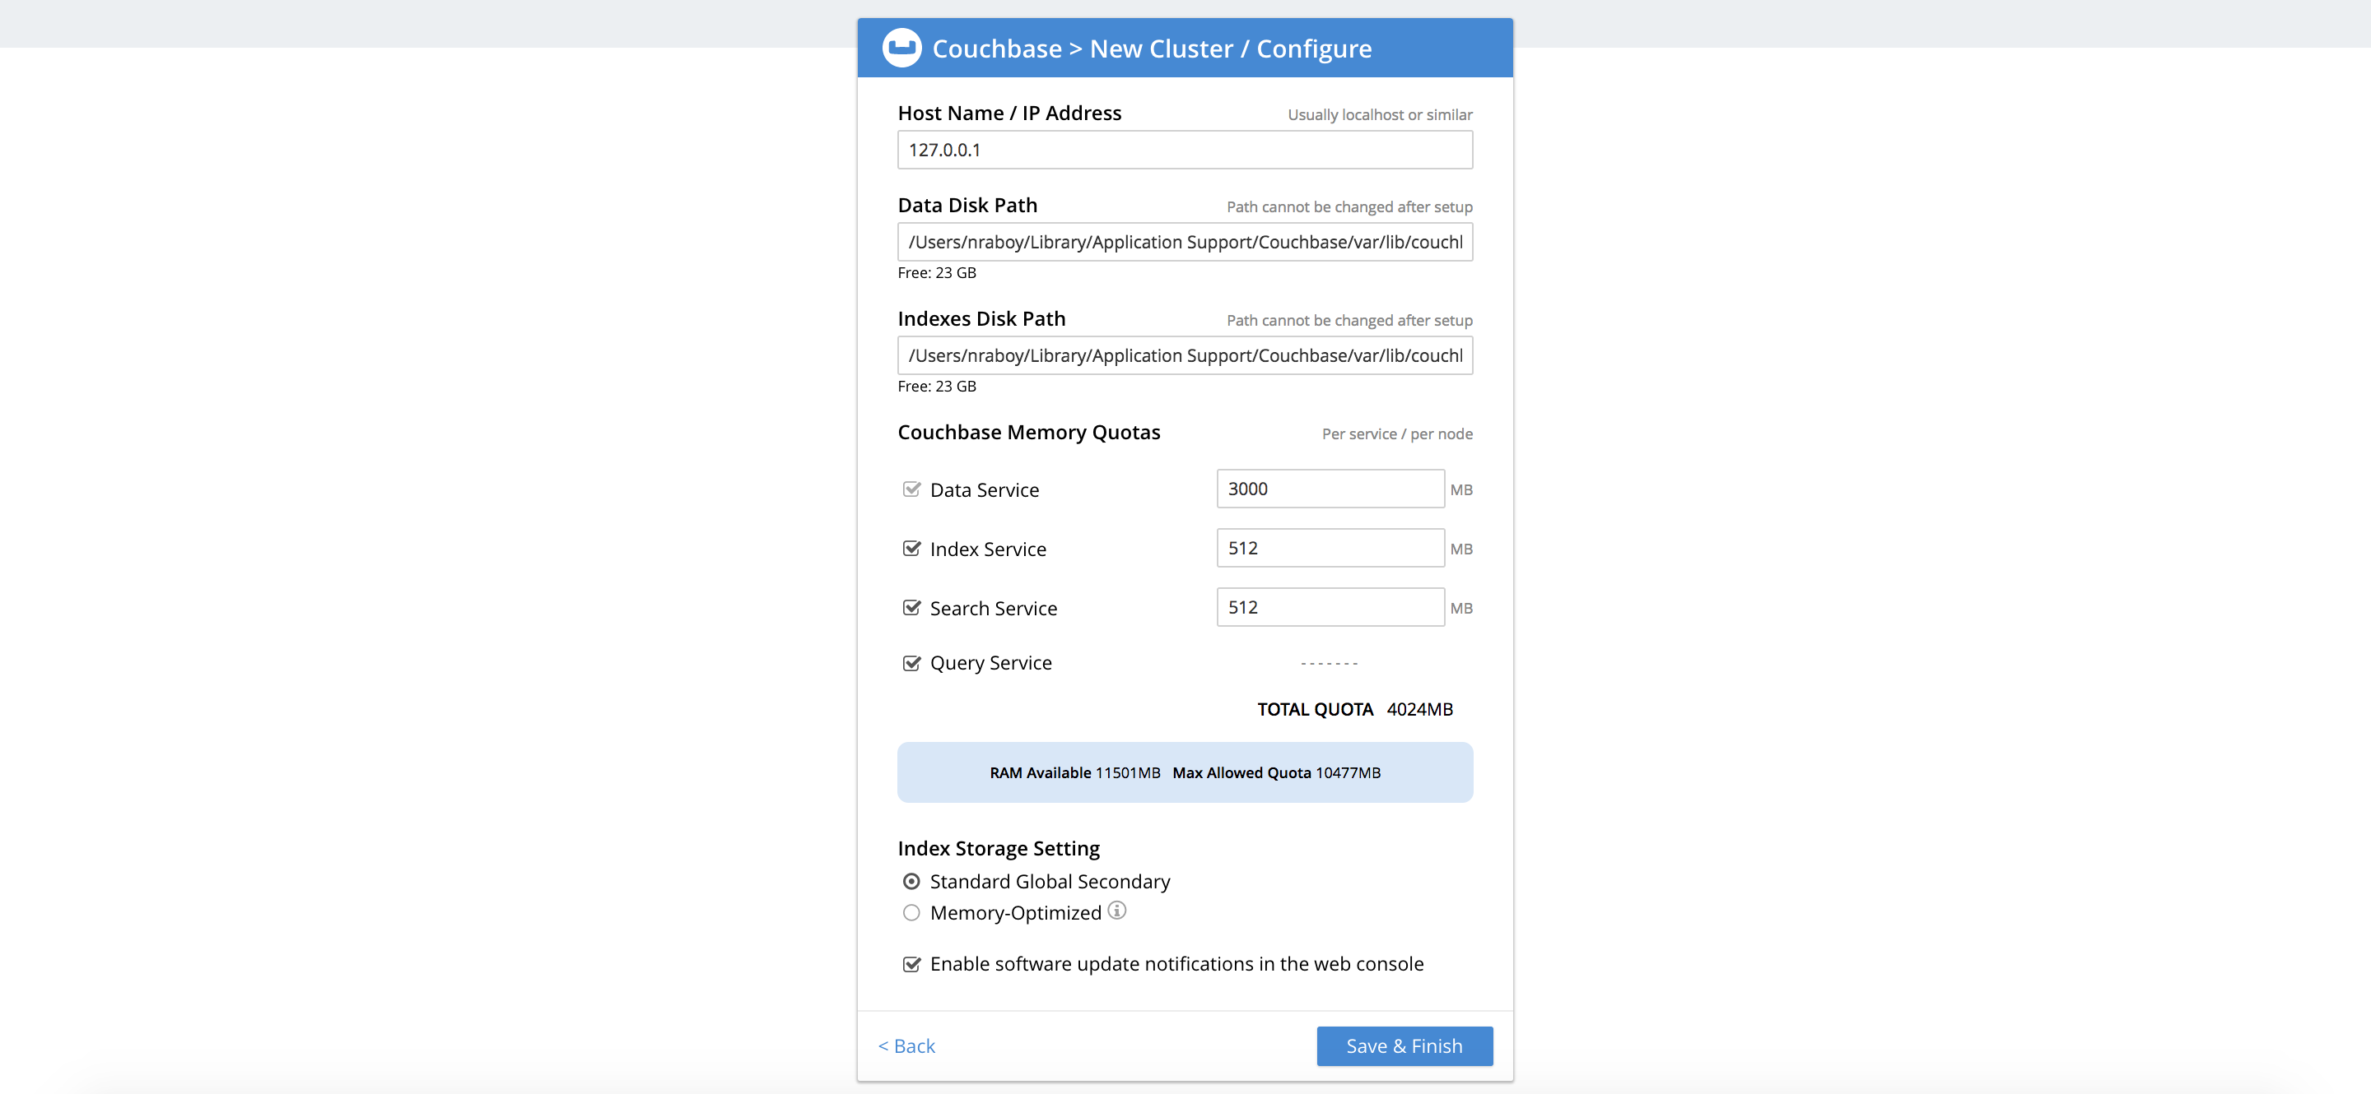
Installing Couchbase

Slide 11
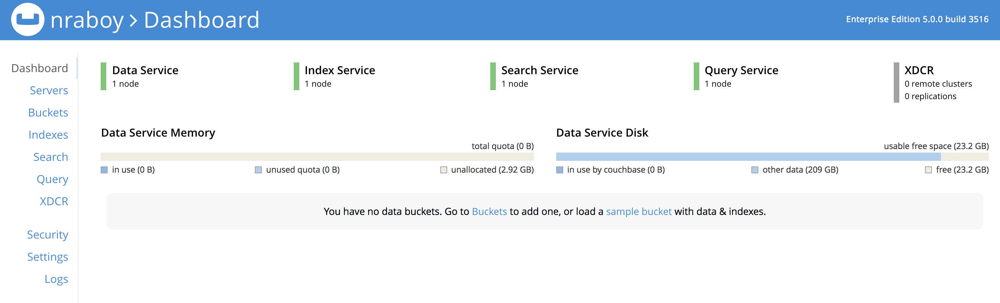
Installing Couchbase

Slide 12
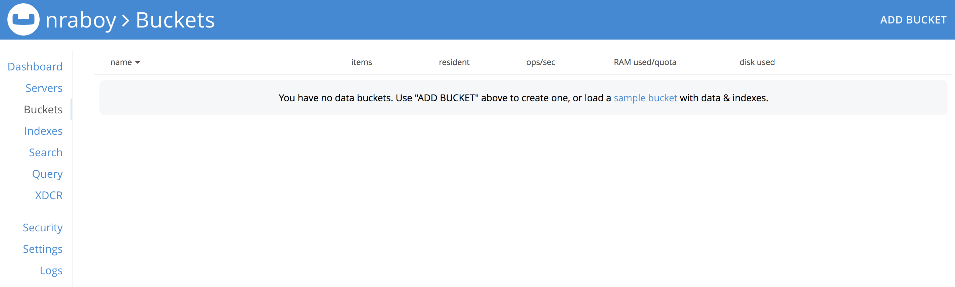
Working with Couchbase

Slide 13
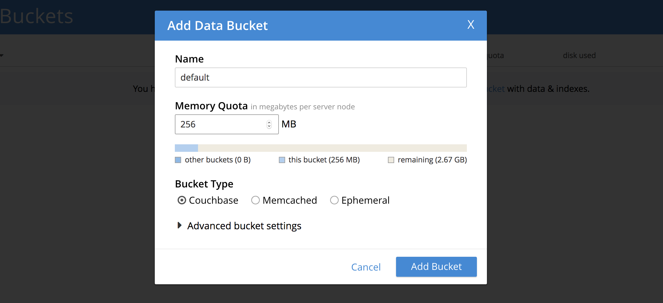
Working with Couchbase

Slide 14
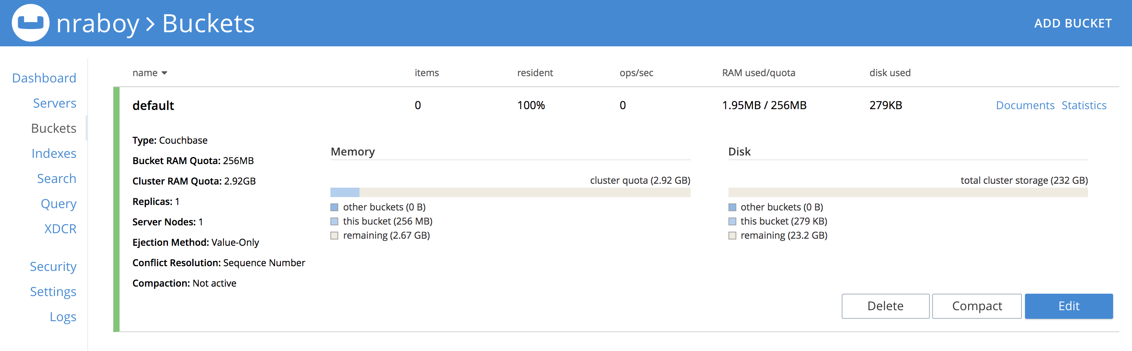
Working with Couchbase

Slide 15
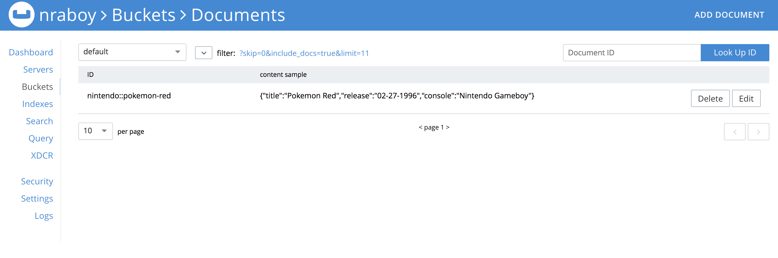
Working with Couchbase

Slide 16
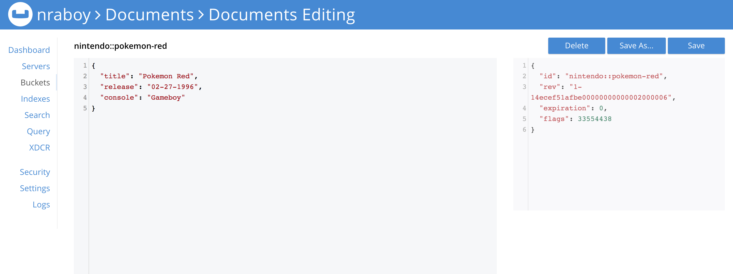
Working with Couchbase

Slide 17
Introduction to Data Modeling

Slide 18
The Plan – Introduction to Data Modeling
Designing a Document Key
Embedding Data as Complex JSON in Documents
Create References Between Documents

Slide 19
Building a Document Key
Key design is as important as document design.
There are three broad types of key:
Human readable/deterministic: e.g. an email address
Computer generated/random: e.g. UUID
Compound: e.g. UUID with a deterministic portion

Slide 20
Human Readable Document Keys
key: nic@couchbase.com
{
"name": ”Nic Raboy",
”email”: ”nic@couchbase.com",
"address": ”450 Mission Street",
"city": ”San Francisco”,
“state”: “CA”
}

Slide 21
Generated Document Keys
key: f8d8d616-6ce0-4344-9793-4ec5a676c223
{
"name": ”Nic Raboy",
”email”: ”nic@couchbase.com",
"address": ”450 Mission Street",
"city": ”San Francisco”,
“state”: “CA”
}

Slide 22
Compound Document Keys
key: profile::f8d8d616-6ce0-4344-9793-4ec5a676c223
{
"name": ”Nic Raboy",
”email”: ”nic@couchbase.com",
"address": ”450 Mission Street",
"city": ”San Francisco”,
“state”: “CA”
}

Slide 23
Mixed Document Key Example
key: f8d8d616-6ce0-4344
key: facebook::1234
{
"name": ”Nic Raboy",
”email”: ”nic@couchbase.com",
"address": ”450 Mission Street",
"city": ”San Francisco”,
“state”: “CA”
}
{
“profile”: “f8d8d616-6ce0-4344”
}
key: twitter::1234
{
“profile”: “f8d8d616-6ce0-4344”
}

Slide 24
Relational Databases
Customers
customer | firstname | lastname
2342 | Nic | Raboy
Products
product | name
7182 | Nintendo Switch
SELECT
c.firstname, c.lastname, p.name, o.total
FROM invoice AS i
JOIN order AS o ON i.order = o.order
JOIN product AS p ON i.product = p.product
JOIN customer AS c ON o.customer = c.customer
Orders
order | total | customer
1234 | $299.99 | 2342
Invoice
order | product | quantity
1234 | 7182 | 2

Slide 25
The Embedded Approach
Customers
customer | firstname | lastname
2342 | Nic | Raboy
{
"order": 1234,
"customer": {
"customer": "2342",
"firstname": "Nic",
"lastname": "Raboy"
},
"products": [
{
"product": 7182,
"name": "Nintendo Switch"
}
],
"total": "$299.99"
}
Products
product | name
7182 | Nintendo Switch
Orders
order | total | customer
1234 | $299.99 | 2342
Invoice
order | product | quantity
1234 | 7182 | 2

Slide 26
The Referenced Approach
Customers
customer | firstname | lastname
2342 | Nic | Raboy
{
"firstname": "Nic",
"lastname": "Raboy"
}
Products
product | name
7182 | Nintendo Switch
{
"name": "Nintendo Switch"
}
{
"order": 1234,
"product": 7182,
"quantity": 2
}
Orders
order | total | customer
1234 | $299.99 | 2342
Invoice
order | product | quantity
1234 | 7182 | 2
{
"customer": 2342
"total": "$299.99"
}

Slide 27
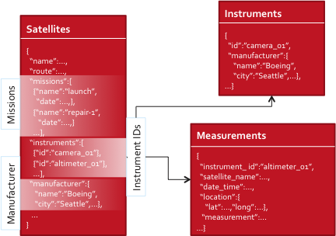
Embedding vs Referencing
Embed When
Both docs are frequently access together.
You need strict consistency between both docs.
Reference When
Both docs aren’t frequently access together.
You need strict consistency for the referenced information
Need to optimize for performance and referenced doc is large

Slide 28
Evolving Data Models
Change your code and you are good to go!
Schema is App Driven in Couchbase Server
OK to maintain multiple versions of the schema
Schema Changes with Couchbase Server
No Explicit Server Action Required by DBA
No Downtime required to update existing data to new shape

Slide 29
Getting Started with the Workshop

Slide 30
The Plan – Getting Started with the Workshop
Get Hands-On Experience with Couchbase Server and the SDKs
Include Couchbase in a Node.js, Java, or .NET application
Java with Spring Boot
Node.js with Hapi
.NET
Develop RESTful Endpoints using Features in Couchbase

Slide 31
Workshop on GitHub
https://github.com/couchbaselabs/workshop

Slide 32
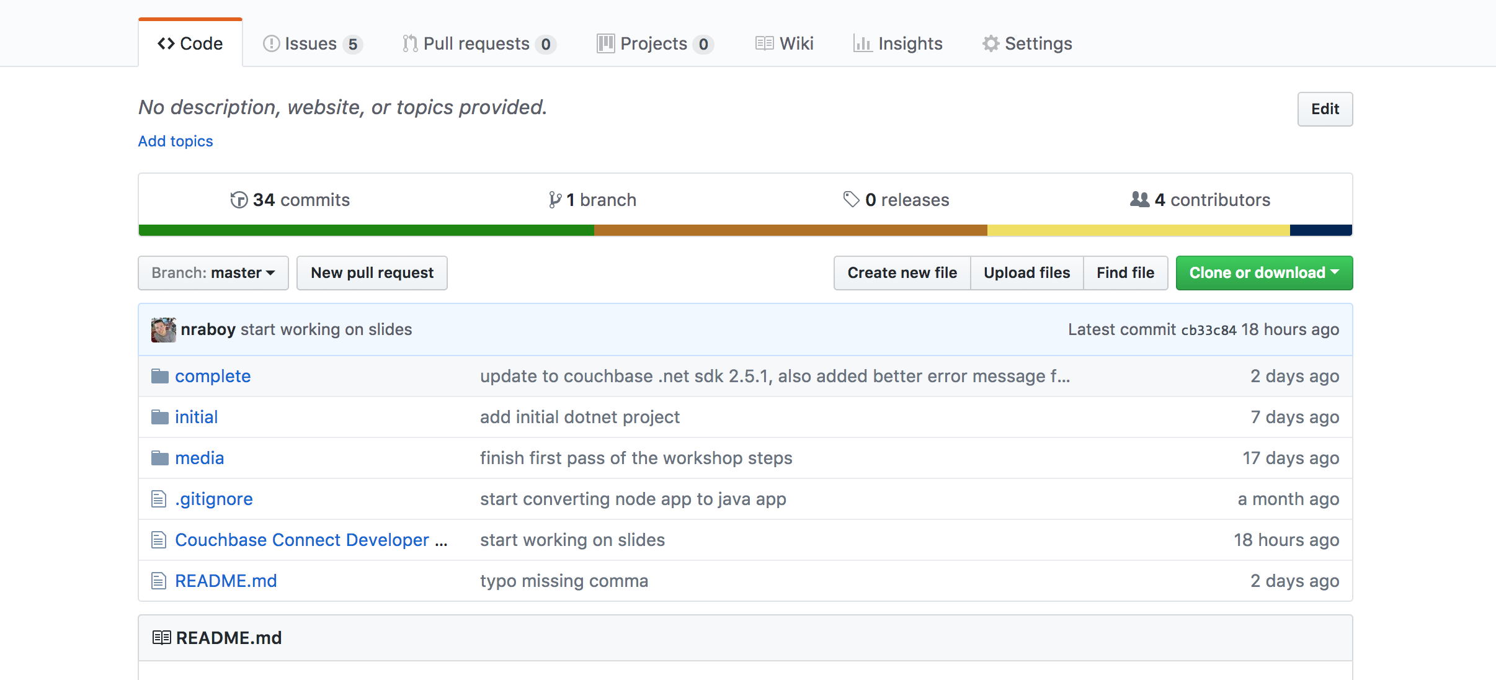
Workshop Material

Slide 33
The Application Basics

Slide 34
Including the SDK
// Gradle
dependencies {
...
compile group: 'com.couchbase.client', name: 'java-client', version:'2.5.0’
...
}
// Maven
<dependencies>
<dependency>
<groupId>com.couchbase.client</groupId>
<artifactId>java-client</artifactId>
<version>2.5.0</version>
</dependency>
</dependencies>
// Node Package Manager (NPM)
npm install couchbase --save

Slide 35
Connection Basics
// Node.js
const Couchbase = require("couchbase");
var N1qlQuery = Couchbase.N1qlQuery;
const cluster = new Couchbase.Cluster("couchbase://<host>");
cluster.authenticate(”<username>", ”<password>");
const bucket = cluster.openBucket(”<bucket-name>");
// Java
import com.couchbase.client.java.CouchbaseCluster;
import com.couchbase.client.java.CouchbaseBucket;
CouchbaseCluster cluster = CouchbaseCluster.create("couchbase://<host>");
cluster.authenticate("<username>", "<password>");
CouchbaseBucket bucket = cluster.openBucket("<bucket-name>");

Slide 36
Configuring And Using Role-Based Access Control

Slide 37
The Plan – Configuring Role-Based Access Control
Understand the Access Controls in Couchbase
Create an Application User

Slide 38
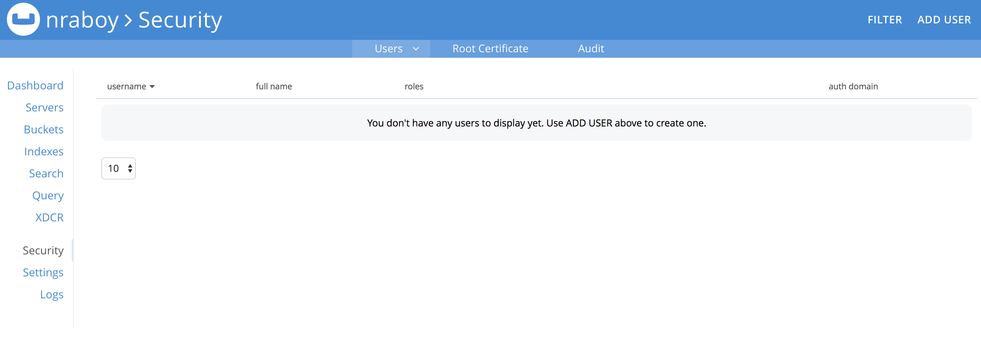
Role-Based Access Control (RBAC)

Slide 39
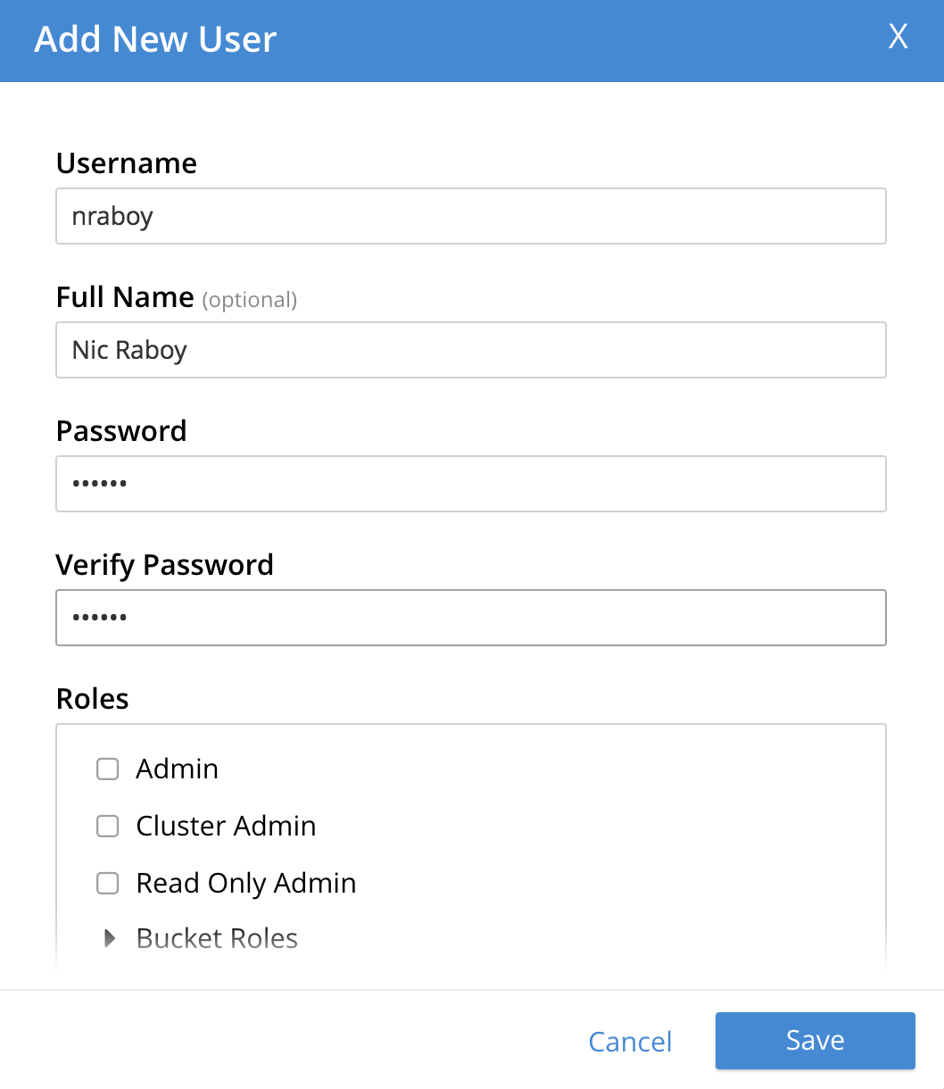
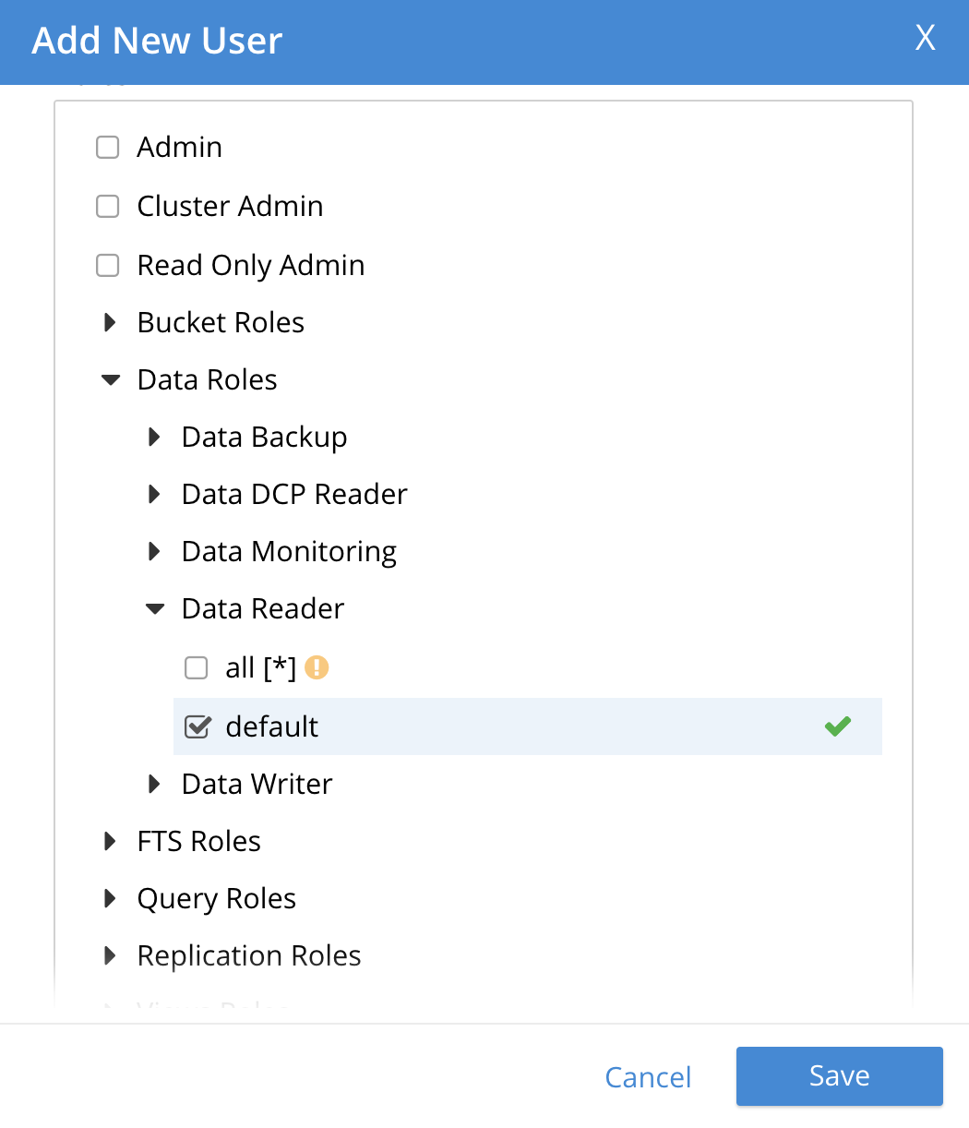
Role-Based Access Control (RBAC)
Cluster and Bucket Permissions
Data Reader / Writer for CRUD
Query for N1QL
FTS for Full Text Search

Slide 40
RBAC in the SDK
// Node.js
cluster.authenticate(”<username>", ”<password>");
// Java
cluster.authenticate(“<username>”, “<password>”);
// .NET
IAuthenticator auth = new PasswordAuthenticator(”<username>", ”<password>");
cluster.Authenticate(auth);

Slide 41
CRUD Operations in Couchbase

Slide 42
The Plan – CRUD Operations in Couchbase
Create Data in Couchbase with the Node.js, Java, or .NET SDKs
Retrieve Documents from Couchbase by Document Key

Slide 43
Creating Documents
JsonObject data = JsonObject.create()
.put("firstname", "Nic")
.put("lastname", "Raboy");
JsonArray address = JsonArray.create()
.add(JsonObject.create().put("city", "Mountain View").put("state", "CA"))
.add(JsonObject.create().put("city", "San Francisco").put("state", "CA"));
data.put("address", address);
bucket.insert(JsonDocument.create("person-1", data));
var data = {
"firstname": "Nic",
"lastname": "Raboy",
"address": [
{
"city": "Mountain View",
"state": "CA"
},
{
"city": "San Francisco",
"state": "CA"
}
]
};
bucket.insert("person-1", data, (error, result) => {});
Data can be flat or complex
Document keys can be custom, automatically generated, or incrementing
The `insert` operator will create new documents if the key does not already exist
The `upsert` operator will create or replace

Slide 44
Retrieving Documents by Key
Data can be retrieved using a key-value lookup or with a N1QL query
Lookups are significantly faster than indexed queries with N1QL
Java has can be asynchronous (non-blocking) with RxJava or synchronous
// Java
bucket.get("person-1").content().toMap();
// Node.js
bucket.get("person-1", (error, result) => {
console.dir(result);
});
// .NET
var result = await _bucket.GetAsync<Model>("person-1");

Slide 45
Querying for Documents with N1QL

Slide 46
The Plan – Querying for Documents with N1QL
Understand the Power of N1QL
Use Query Workbench and the Couchbase CLI
Create Indexes for N1QL Queries
Query for Data with N1QL
Create Data with N1QL
Remove Data with N1QL

Slide 47


What is N1QL?
Non-first (N1) Normal Form Query Language (QL)
It is based on ANSI 92 SQL
Its query engine is optimized for modern, highly parallel multi-core execution
SQL-like Query Language
Expressive, familiar, and feature-rich language for querying, transforming, and manipulating JSON data
N1QL extends SQL to handle data that is:
Nested: Contains nested objects, arrays
Heterogeneous: Schema-optional, non-uniform
Distributed: Partitioned across a cluster
Power of SQL
Flexibility of JSON

Slide 48
N1QL (EXPRESSIVE)
Access to every part of JSON document
Scalar & Aggregate functions
Subqueries in the FROM clause
Aggregation on arrays
Expressive, familiar, and feature-rich language for querying, transforming, and manipulating JSON data

Slide 49
N1QL (FAMILIAR)
SELECT * FROM bucket WHERE …
INSERT single & multiple documents
UPDATE any part of JSON document & use complex filter
DELETE
MERGE two sets of documents using traditional MERGE statement
EXPLAIN to understand the query plan
EXPLAIN SELECT * FROM bucket WHERE …
Expressive, familiar, and feature-rich language for querying, transforming, and manipulating JSON data
Notes:
Give developers and enterprises an expressive, powerful, and complete language for querying, transforming, and manipulating JSON data.

Slide 50
N1QL (FEATURE-RICH)
Access to every part of JSON document
Functions (Date, Pattern, Array, Conditional, etc)
https://developer.couchbase.com/documentation/server/current/n1ql/n1ql-language-reference/functions.html
JOIN, NEST, UNNEST
Covering Index
Prepared Statements
USE KEYS, LIKE
Expressive, familiar, and feature-rich language for querying, transforming, and manipulating JSON data

Slide 51
N1QL - Example
SELECT customers.id,
customers.NAME.lastname,
customers.NAME.firstname
SUM(orderline.amount)
FROM orders UNNEST orders.lineitems AS orderline
JOIN customers ON KEYS orders.custid
WHERE customers.state = 'NY'
GROUP BY customers.id,
customers.NAME.lastname
HAVING SUM(orderline.amount) > 10000
ORDER BY SUM(orderline.amount) DESC

Slide 52
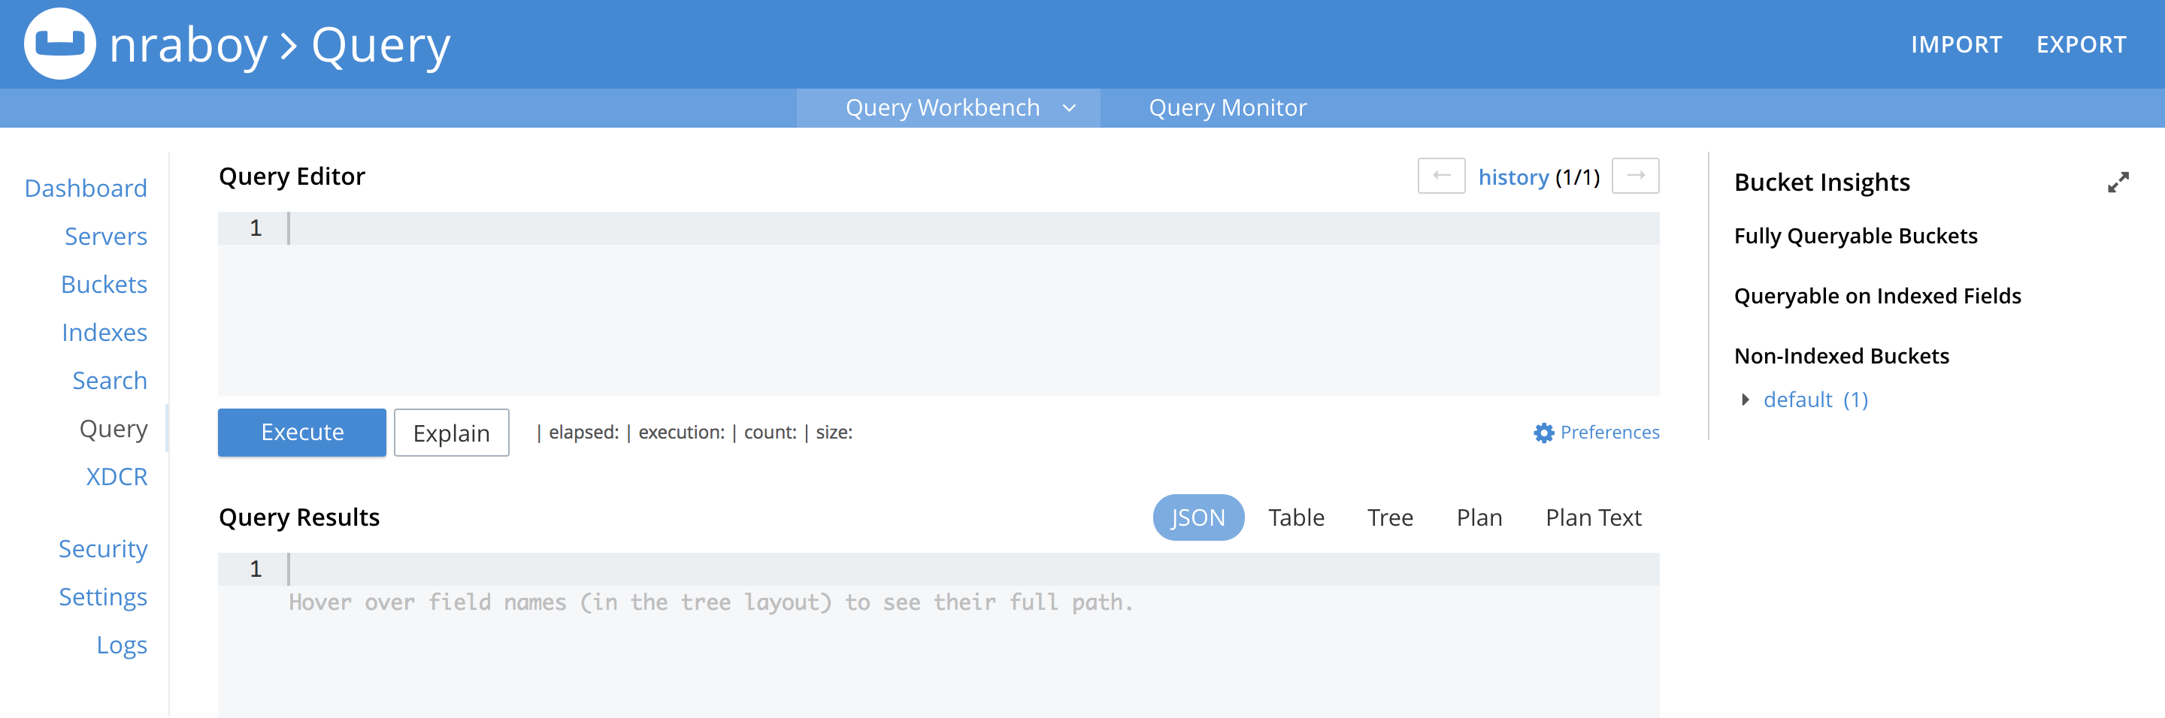
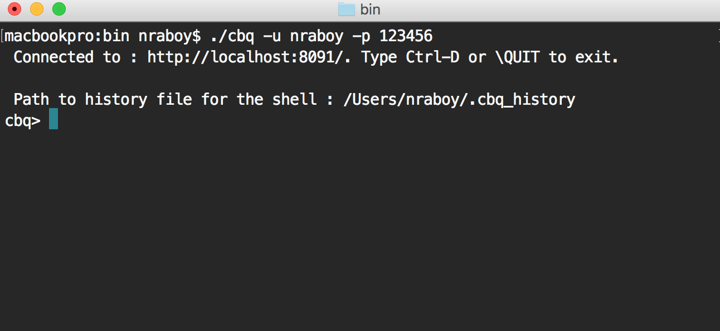
Query Workbench and the Couchbase CLI

Slide 53
Query Workbench and the Couchbase CLI
Query Workbench
http://localhost:8091/ui/index.html#!/query/workbench
Couchbase CLI (Mac)
/Applications/Couchbase Server.app/Contents/Resources/couchbase-core/bin/cbq
Couchbase CLI (Windows)
C:\Program Files\CouchbaseServer\bin\cbq.exe
Couchbase CLI (Linux)
/opt/couchbase/bin/cbq

Slide 54
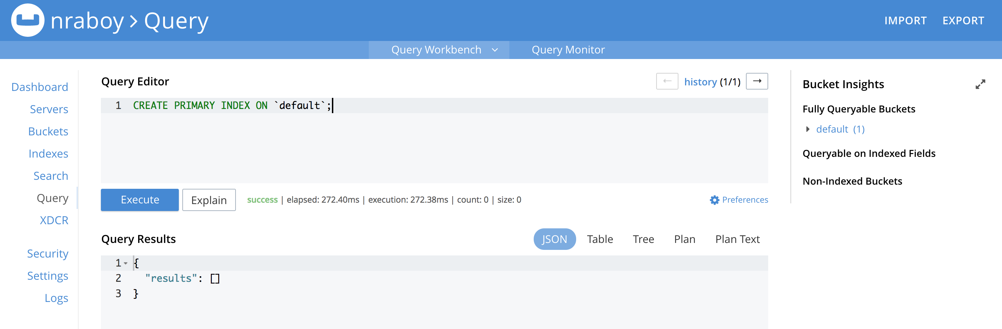
Indexing and Querying in Couchbase Server

Slide 55
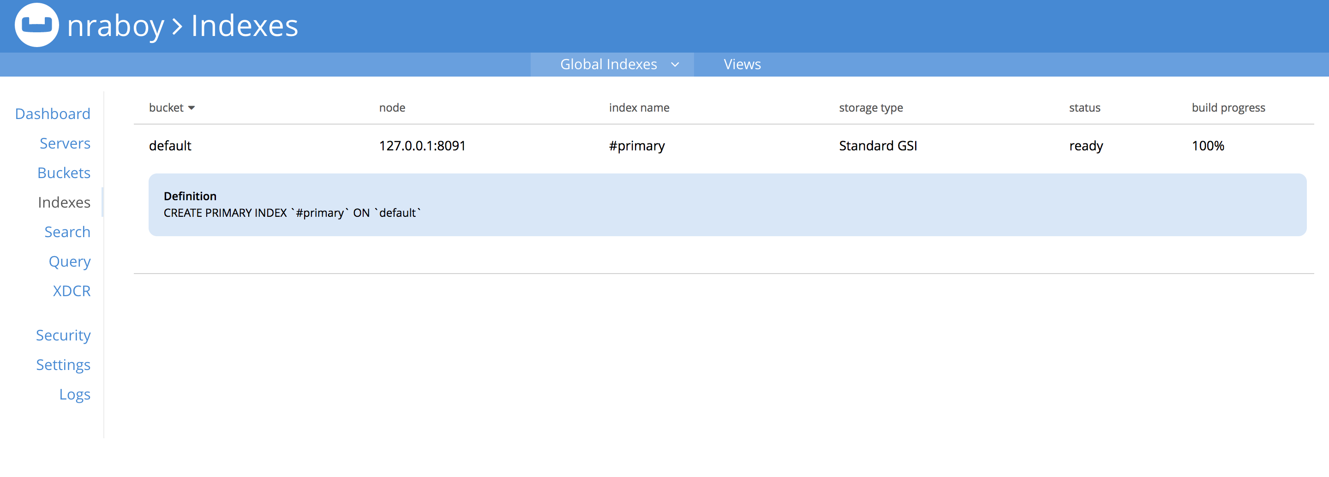
Indexing and Querying in Couchbase Server

Slide 56
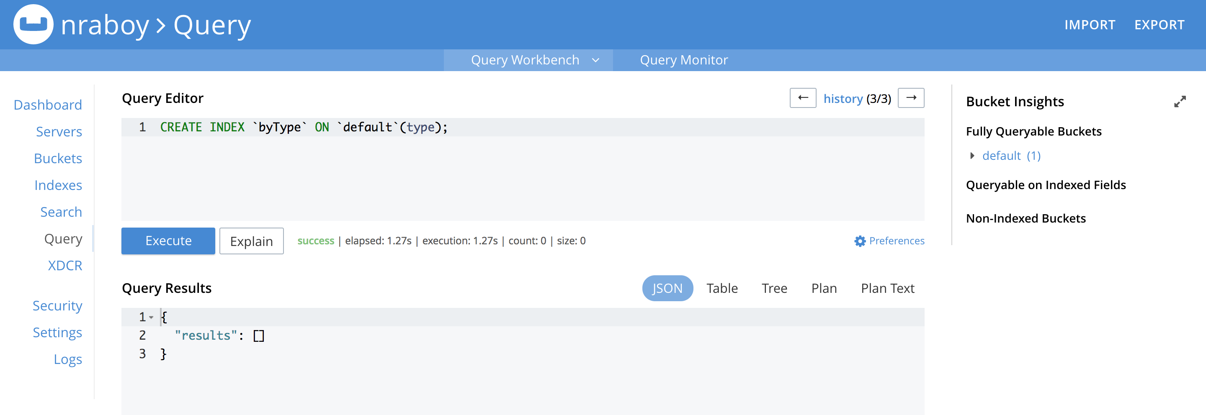
Indexing and Querying in Couchbase Server

Slide 57
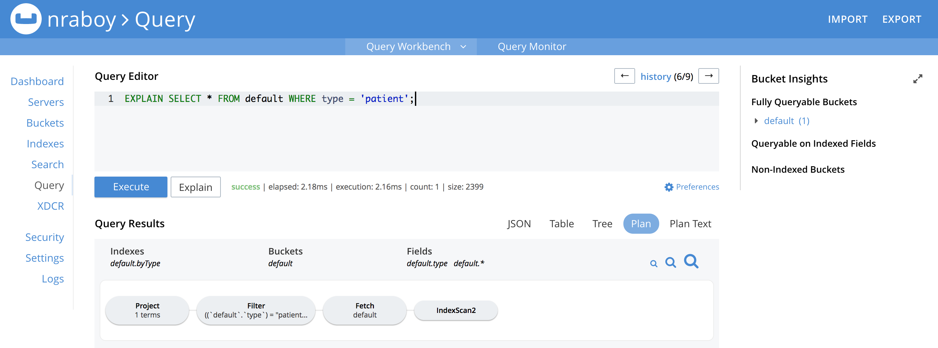
Indexing and Querying in Couchbase Server

Slide 58
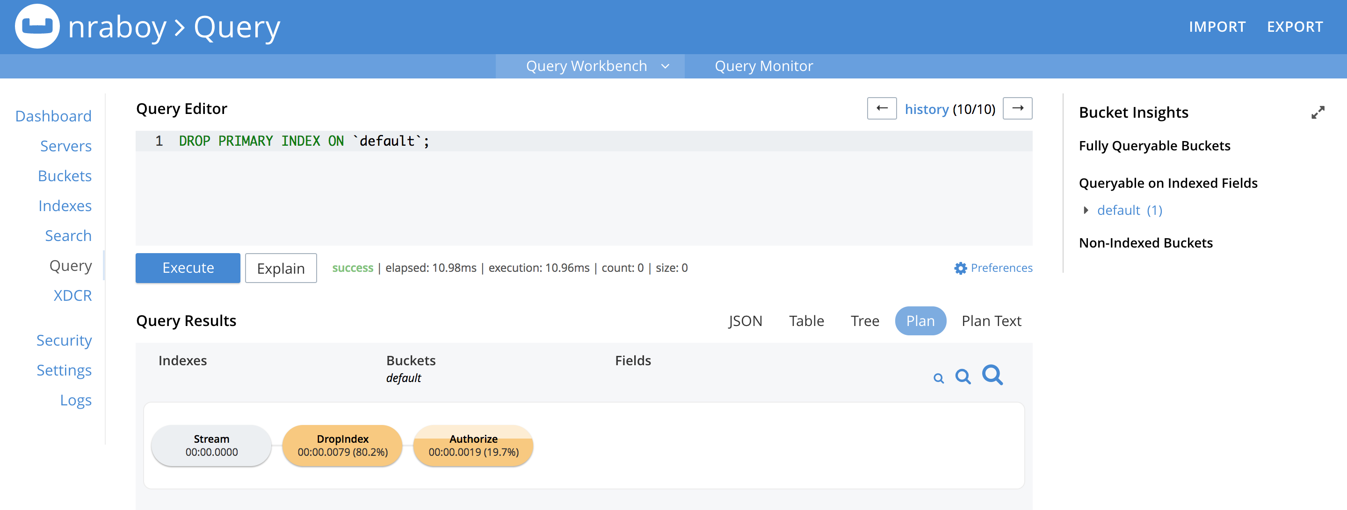
Indexing and Querying in Couchbase Server

Slide 59
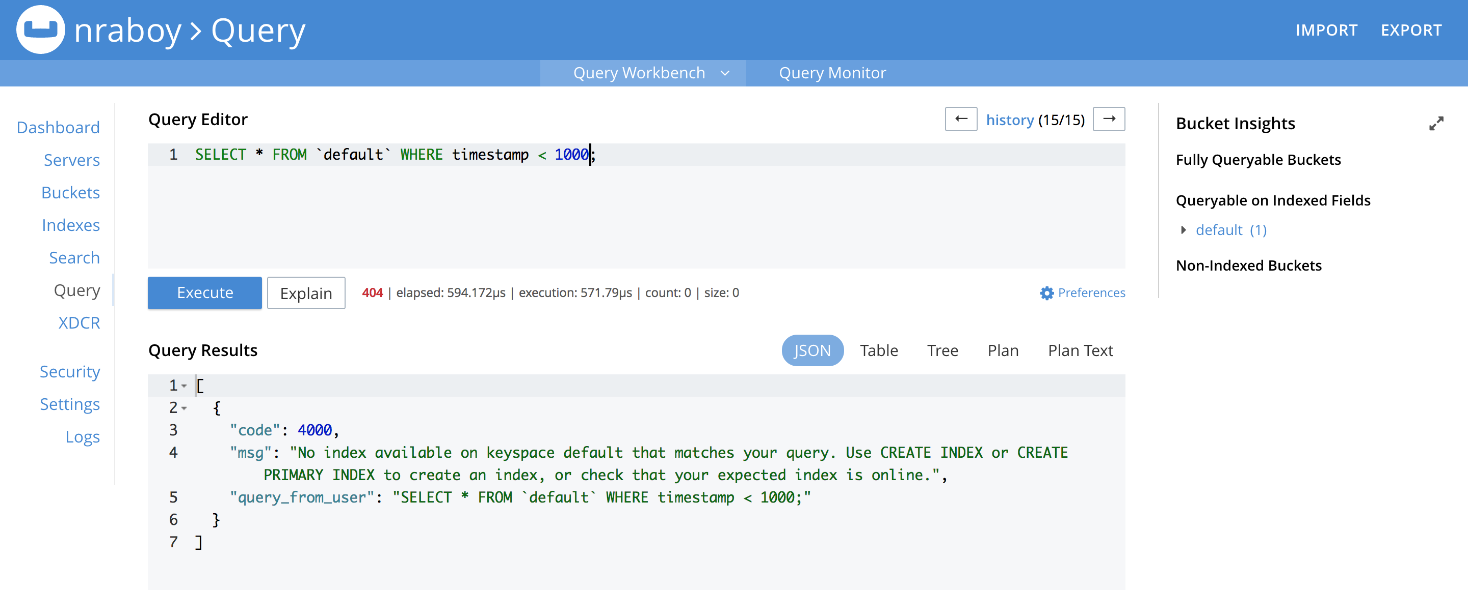
Indexing and Querying in Couchbase Server

Slide 60
Creating Data with N1QL
INSERT INTO `default`
(KEY, VALUE)
VALUES (“person-1”, {
“firstname”: “Nic”,
“lastname”: “Raboy”
})

Slide 61
Deleting Data with N1QL
DELETE FROM `default`
WHERE META().id = ‘person-1’

Slide 62
Working with Parts of a Document

Slide 63
The Plan – Working with Parts of a Document
Get Parts of a NoSQL JSON Document
Update JSON Properties in a Document
Batch Subdocument Operations Together

Slide 64
Large Documents
key: nraboy
{
"profile": {
"firstname": "Nic",
"lastname": "Raboy"
},
"data": [
// 20MB of data
]
}

Slide 65
Get Part of a Document
// Node.js
bucket.lookupIn(”nraboy").get(”profile").execute((error, result) => {
if(error) {
throw error;
}
console.dir(result);
});
// Java
DocumentFragment<Lookup> result = bucket
.lookupIn("nraboy")
.get(”profile")
.execute();

Slide 66
Update Part of a Document
// Node.js
bucket.mutateIn("nraboy", 0, 0).upsert("profile.firstname", "Nicolas", true).execute((error, result) => {
if(error) {
throw error;
}
console.dir(result);
});
// Java
SubdocOptionsBuilder builder = new SubdocOptionsBuilder();
builder.createParents(true);
bucket().mutateIn(”nraboy").upsert(”profile.firstname", "Nicolas", builder).execute();

Slide 67
Chain Subdocument Operations
SubdocOptionsBuilder builder = new SubdocOptionsBuilder();
builder.createParents(true);
DocumentFragment<Mutation> result = bucket
.mutateIn(”nraboy")
.replace(”profile.firstname", ”Nic")
.insert(”profile.gender", ”Male", builder)
.remove(”data")
.withDurability(PersistTo.MASTER, ReplicateTo.NONE)
.execute();

Slide 68
Data Structures
bucket.mapAdd(
“nraboy”,
“name”,
“Nic Raboy”,
{create: true},
(error, result) => {}
);
bucket.mutateIn("nraboy", 0, 0).upsert(”name", ”Nic Raboy”)
.execute((error, result) => {
if(error) {
throw error;
}
console.dir(result);
});

Slide 69
Full Text Search

Slide 70
The Plan – Full Text Search
Create Full Text Search Indexes
Query for Data within a Document
Apply Fuzziness Factors

Slide 71
SQL LIKE Query
SELECT * FROM people WHERE bio LIKE ‘%golang%’;

Slide 72
Full Text Search vs N1QL
Wildcard Queries are Slow
What happens to variations of the wildcard term in N1QL / SQL?
‘%golang%’, does ‘Golang’ or ‘GoLang’ pop up?
‘%golang%’, do spelling errors like ‘goang’ pop up?
FTS is for Natural Language Querying

Slide 73
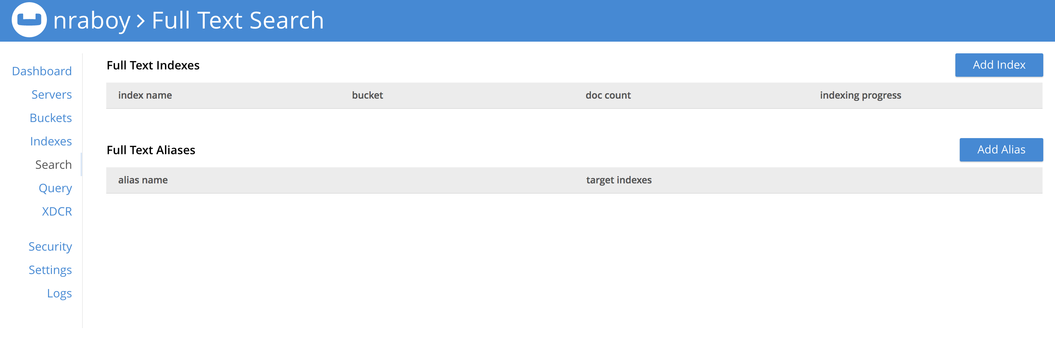
Full Text Search Indexes

Slide 74
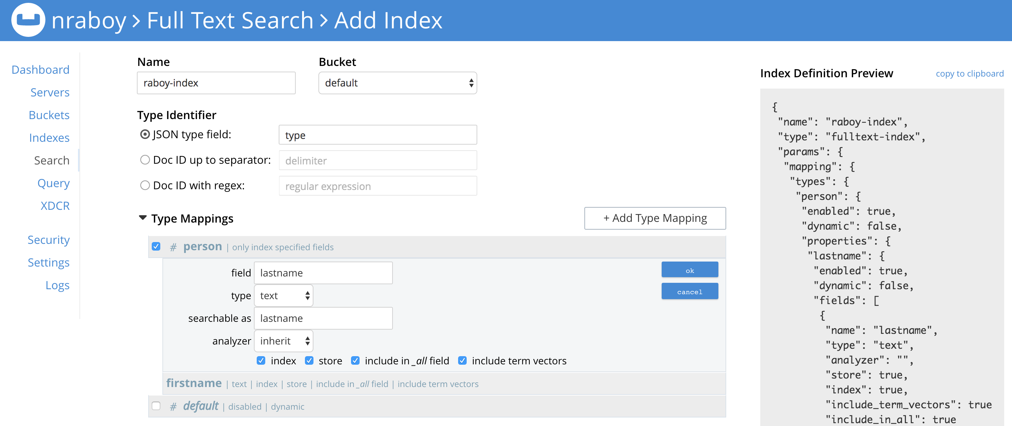
Full Text Search Indexes

Slide 75
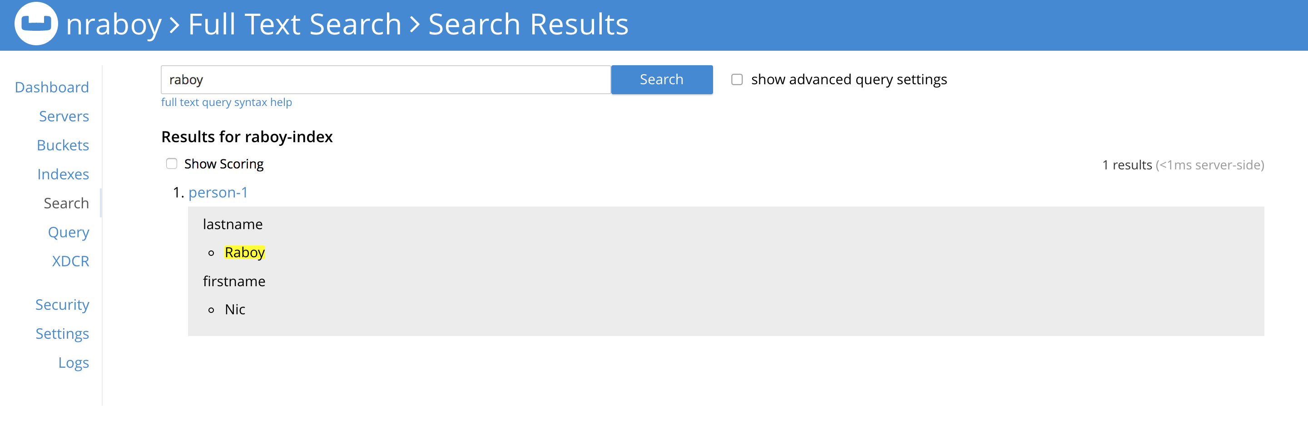
Full Text Search

Slide 76
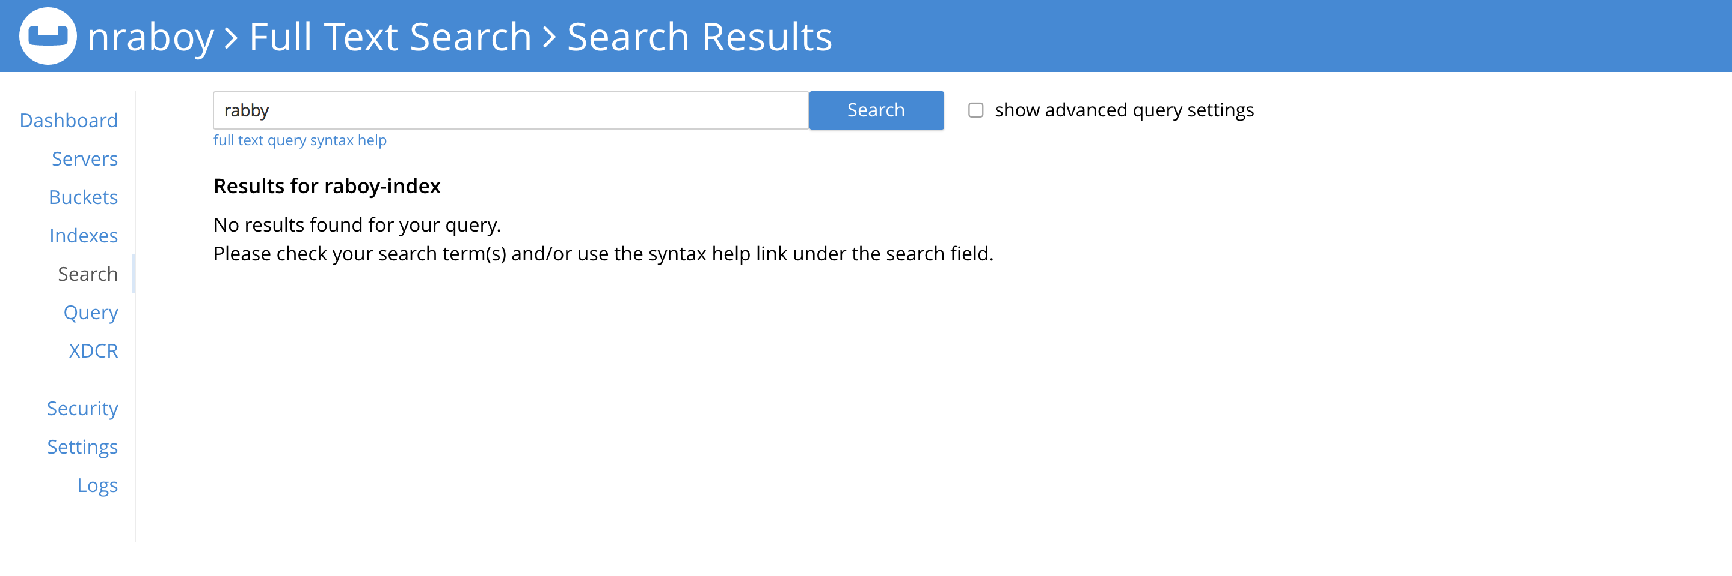
Full Text Search with Fuzziness

Slide 77

Full Text Search with Fuzziness

Slide 78
Types of Full Text Search Queries
Match Query
A match query analyzes the input text and uses that analyzed text to query the index. An attempt is made to use the same analyzer that was used when the field was indexed.
Match Phrase Query
Fuzzy Query
Wildcard Query
Conjunction Query
Range Queries
https://developer.couchbase.com/documentation/server/current/fts/fts-query-types.html

Slide 79
Match Queries
// Node.js
var SearchQuery = Couchbase.SearchQuery;
var query = SearchQuery.new(”raboy-index", SearchQuery.match(”mountain dew"));
query.fields(["FIELDS", "TO", "RETURN", "WITH", "PATH", "DEFINED"]);
bucket.query(query, callback);
// .NET
var match = new MatchQuery(”mountain dew");
var query = new SearchQuery
{
Index = ”raboy-index",
Query = match,
SearchParams = new SearchParams().Fields("FIELDS", "TO", "RETURN")
};
var result = await _bucket.QueryAsync(query);

Slide 80
Common Obstacles

Slide 81
Query Consistency
Documents that have been created are not appearing in the results of a N1QL query!

Slide 82
Query Consistency
not_bounded
Fastest
Returns data that is currently indexed and accessible by the index or the view.
at_plus
Fast
A query submitted with at_plus consistency level requires all mutations, up to the moment of the scan_vector (the logical timestamp passed in with at_plus), to be processed before the query execution can start.
request_plus
Slowest, but still fast
Requires all mutations, up to the moment of the query request, to be processed before the query execution can start.

Slide 83
Query Consistency
// Node.js
var query =
N1qlQuery.fromString(statement).consistency(N1qlQuery.Consistency.REQUEST_PLUS);
// Java
N1qlQueryResult result =
bucket.query(
N1qlQuery.simple(
statement,
N1qlParams.build().consistency(ScanConsistency.REQUEST_PLUS)
)
);

Slide 84
Query Performance
Queries are too slow for a production environment!

Slide 85
Query Performance

Slide 86
THANK YOU

Slide 87
What’s Next – More Help
Couchbase Developer Portal – https://developer.couchbase.com
Couchbase Tutorials – https://blog.couchbase.com
Forums – https://forums.couchbase.com
Twitter - @couchbase, @couchbasedev, @nraboy

